Slide 1

Steering Behaviors
Flocking and other Techniques

Slide 2

Steering Behaviors
Steering behaviors dictate how an agent moves.
Steering behaviors…
Use a steering vector
Use (conflicting) behaviors as influences
Usually involve incremental changes
Usually produce lifelike behavior
Some common steering behaviors:
Individual Path Following
Crowd Path Following
Flocking & Swarming

Slide 3
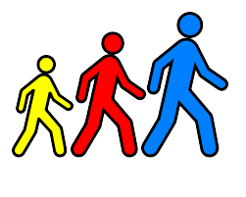
Path Following
Path Following is steering behavior used to follow a target path.
Path Following:
Operates on a predefined path
Follows general direction of path
Applies a force in the direction of the path
Path Following Isn’t:
A rigid process to match a path
A way to find a valid path
Crowd Path Following introduces separation.

Slide 4
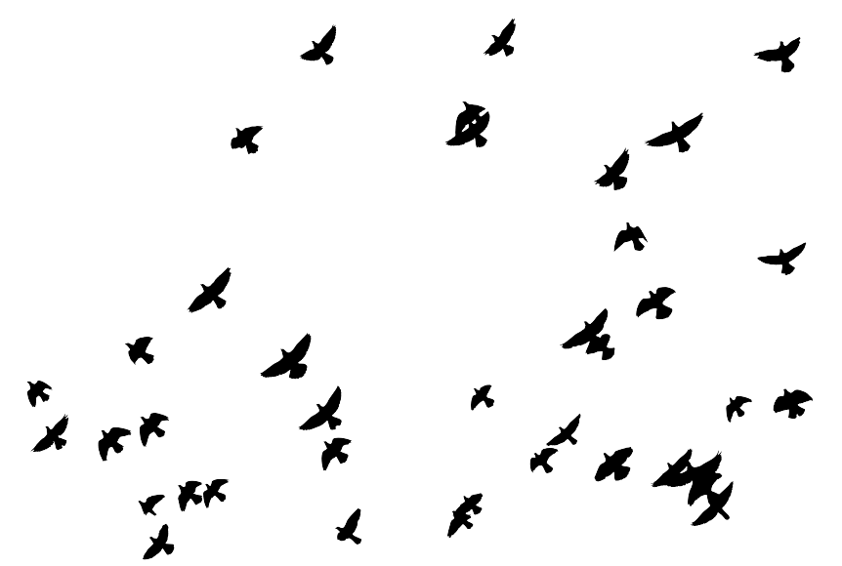
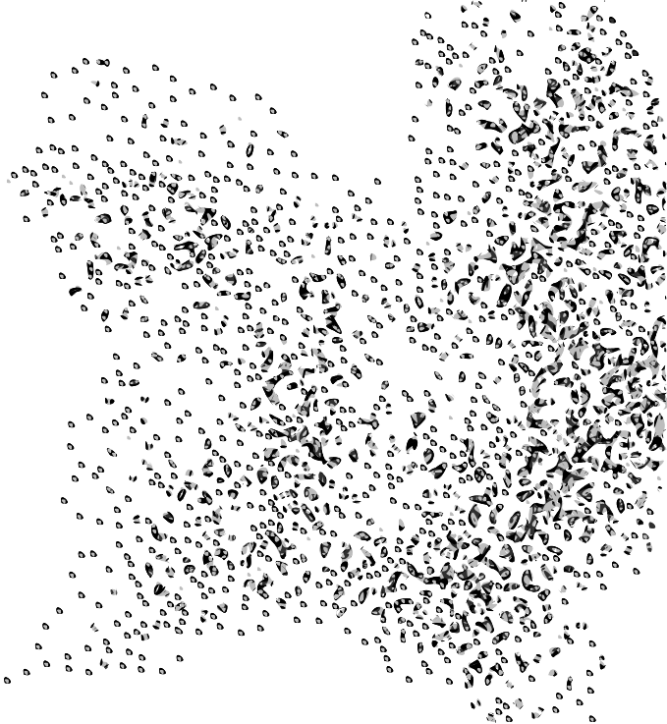
Flocking
Flocking is a steering technique that incorporates several factors to create lifelike flock & swarm behaviors.
In Flocking…
Individual agents have own steering vectors
Influence of behaviors determined by a strength weight
Behaviors influence individuals incrementally
Direction changes determined by group average
Three main forces in flocking generate group behaviors:
Alignment
Cohesion
Separation

Slide 5
Flocking Implementation
class Flock:
boids = []
avg_forward = vector()
avg_position = vector()
alignment_strength = 1
cohesion_strength = 1
separation_strength = 1
flock_radius = 10
# Method List
#
# update(delta_time)
# calc_alignment_accel(boid)
# calc_cohesion_accel(boid)
# calc_separation_accel(boid)
...
def update(self, delta_time):
self.avg_forward = get_avg_forward(self.boids)
self.avg_position = get_avg_position(self.boids)
for boid in boids:
accel = self.calc_alignment_accel(boid)
accel = accel + self.calc_cohesion_accel(boid)
accel = accel + self.calc_separation_accel(boid)
accel = accel * boid.max_speed * delta_time
boid.velocity = boid.velocity + accel
# Cap magnitude based on the boid's max speed
if boid.velocity.get_magnitude() > boid.max_speed:
boid.velocity.normalize()
boid.velocity = boid.velocity * boid.max_speed
boid.update()
...

Slide 6
Flocking Implementation
def calc_alignment_accel(self, boid):
accel = self.avg_forward / boid.max_speed
if accel.get_magnitude() > 1:
accel.normalize()
return accel * self.alignment_strength
...
def calc_cohesion_accel(self, boid):
accel = self.avg_position – boid.position
distance = accel.get_magnitude()
accel.normalize()
# Set speed based on distance from flock
if distance < self.flock_radius:
accel = accel * distance / flock_radius
return accel * self.cohesion_strength
...

Slide 7
Flocking Implementation
def calc_separation_accel(self, boid):
sum = vector()
for sibling in self.boids:
if boid == sibling:
continue
accel = boid.position – sibling.position
distance = accel.get_magnitude()
safeDistance = boid.safeRadius + sibling.safeRadius
# If a collision is likely…
if distance < safeDistance:
# Scale vector according to how close boids are
accel.normalize()
accel = accel * (safeDistance – distance) / safeDistance
sum = sum + accel
if sum.get_magnitude() > 1.0:
sum.normalize()
return sum * self.separation_strength

Slide 8
Steering Behaviors Benefits & Drawbacks
Benefits
Agents retain individual, lifelike behaviors
Group vectors allow for simple, cheap calculations
Behavior influence on flock can be increased or reduced easily
Weight adjustments are immediately realized in agent behavior
Agents react quickly to changes or obstacles in the world
Drawbacks
Don’t work well in indoor environments or with lots of obstacles
No built-in constraints, like keeping out of certain areas
Do not engage in path planning – only motion
Can be prone to oscillation

Slide 9
References
C. Reynolds. 1999. Steering Behaviors For Autonomous Characters. GDConf 1999.

